Slide 1
Ensuring Continuous Relevance in a Dynamic World
Shiv Vignesh
Prateek Mehta

Slide 2
Motivation
As models are deployed in dynamic environments, they face two major challenges impacting their performance:-
Encounter scenarios/Data not adequately represented in training data
Data/Concept drift which refers to change in data distribution over time
These changes mean that models can quickly lose relevance.
We are creating an adaptive system based on human feedback which will try to update the model aiming to keep it relevant forever.
This project holds significance in the broader context of deploying machine learning models in dynamic, real-world settings, where continuous adaptation is crucial for maintaining optimal performance.

Slide 3
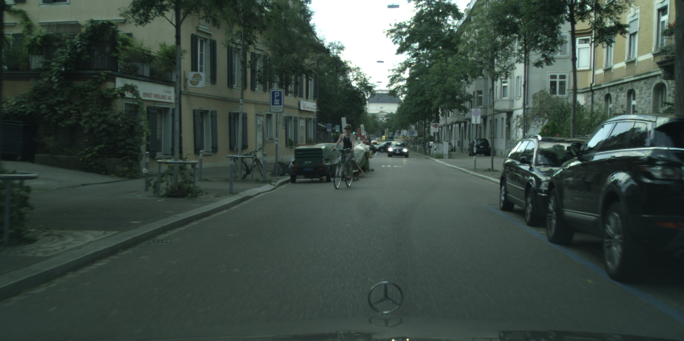
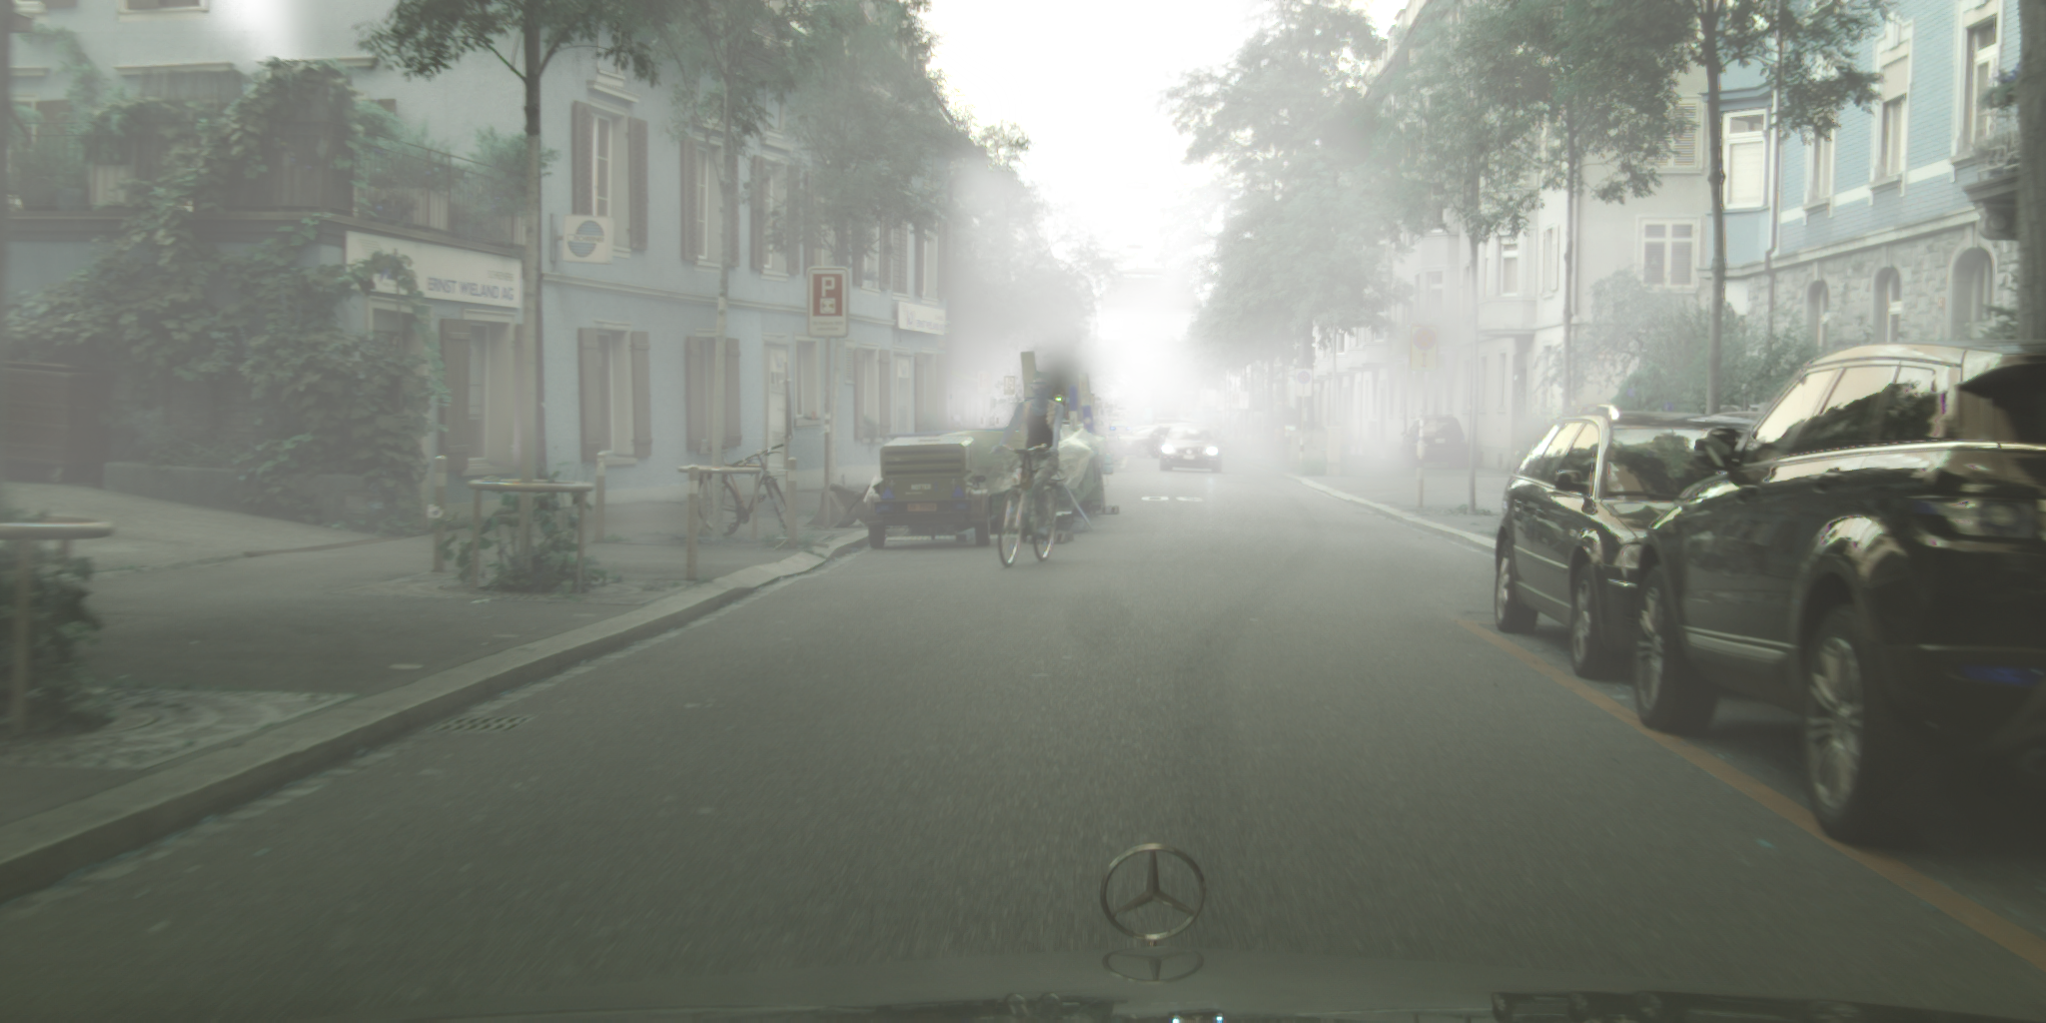
Motivation Example
Training Dataset Example
Perfect weather in Zurich
Real World Domain Change Example
Foggy weather in Zurich

Slide 4
Challenges in Domain Adaptation
Domain changes often lead to sharp decreases in model accuracy
Model retraining from scratch is often infeasible due to:-
Resources and compute required
Adapted domain may not have proper datasets

Slide 5
Towards The Solution
What is the aim?
We have to finetune the model by selecting subregions in images that provide the best improvement.
What’s the challenge?
Determination of the best subregions.
How to overcome the challenge?
Combine principles of active learning and reinforcement learning
Model queries for best regions with active learning
The best regions are determined by training a DDQN

Slide 6
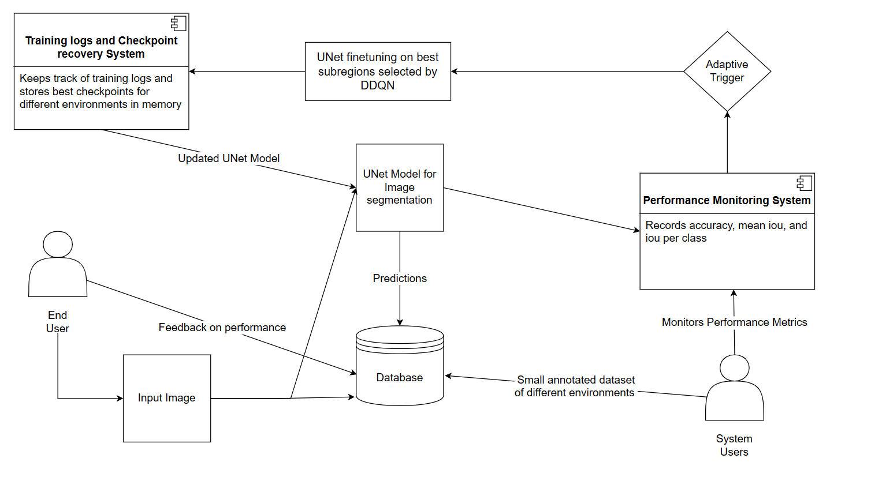
System Diagram (Example Real World System)

Slide 7
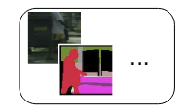
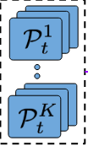
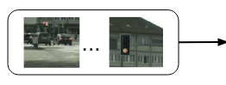
System Diagram
4. Select Region with Q_{max} per pool. Add to Labelled Pool
5. Train U-net on Updated Labelled Pool
Labelled Pool
2. Sample Pool of Unlabelled Regions
State Features
- Entropy
- Prediction Distribution
U-Net
Query Network
Unlabelled Pool
Per Region Per Pool
Action Features
- Entropy
- Prediction Distribution
1. Compute State
State Dataset
Reward Dataset
3. Compute Current Reward

Slide 8
Solution Setup
Datasets
State Dataset (DS): 10
Used to represent state. Representative of entire dataset.
Reward Dataset (DR): 200
Used to calculate Reward
Training Dataset (DT): 150
Used to train subregion selection using DDQN
Validation Dataset (DV): 2615
Used to validate performance of DDQN by calculating performance metric of updated U-Net

Slide 9
State Representation
Each Image is split into equal sized subregions
For each crop, we calculate
Label Distributions of each class
Entropy
Min pooling
Avg pooling
Max pooling
Normalize these features
States = [normalized label distribution, normalized min pooled, normalized avg pooled, normalized max pooled]

Slide 10
Reward Representation
For each crop on the Reward Dataset, we calculate
accuracy of model
mean iou score
iou score per class
Reward = Mean iou of current iteration - Mean iou of previous iteration

Slide 11
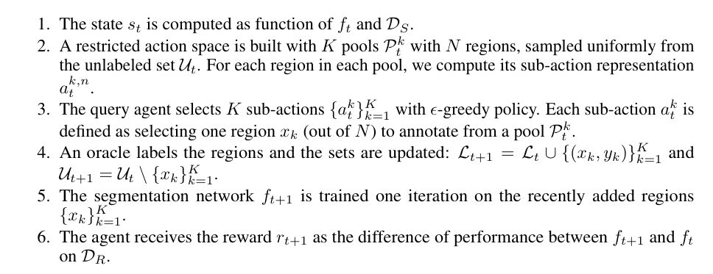
Pseudo code

Slide 12
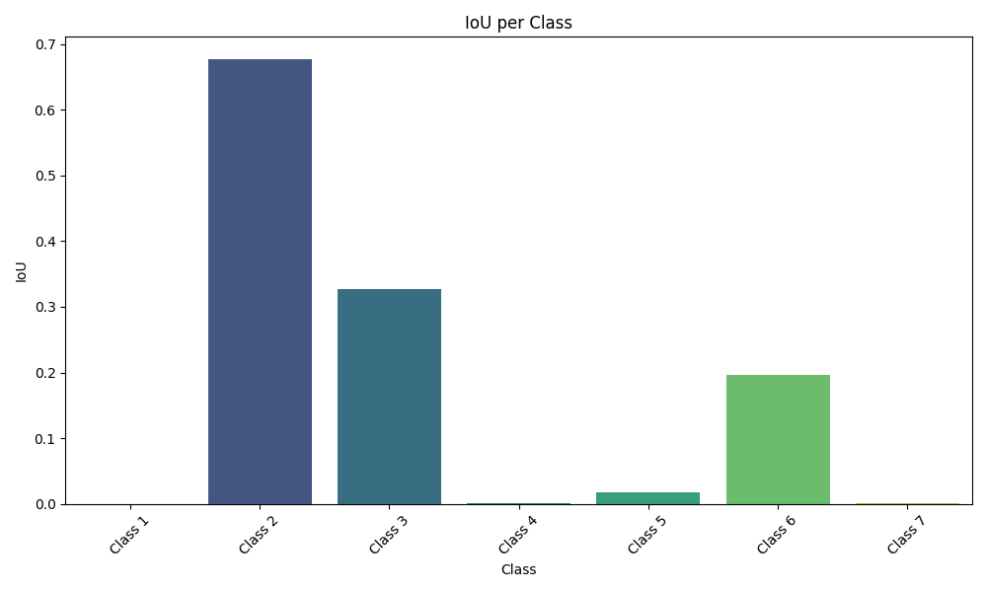
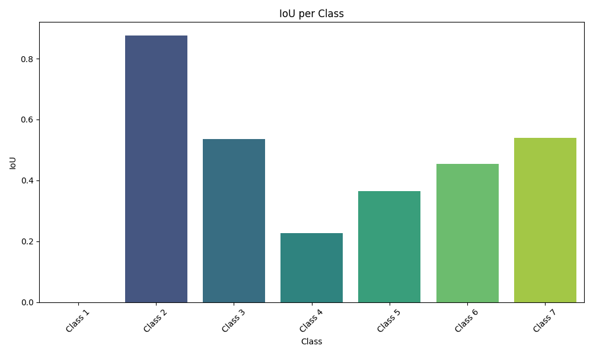
Results
Overall Accuracy - 0.49
Mean IOU - 0.17
IOU Per Class
[0.0, 0.67, 0.32, 0.0, 0.36, 0.19, 0.016]
Overall Accuracy - 0.72
Mean IOU - 0.42
IOU Per Class
[0.0, 0.87, 0.53, 0.22, 0.36, 0.45, 0.53]

Slide 13
Conclusion
By using this approach framework, we managed to show that:-
Domain adaptation is possible without having to retrain model from scratch
Domain adaptation can be done with a very small dataset

Slide 14
Future work
Increase in performance of domain adapted model
Change RL algorithm to an on-policy algorithm to better suit dynamically changing environments

Slide 15
Questions?

Slide 16
Thank You

